Slide 1


Presentation Intelligent Robotics
Group 24
Simone Osti
Christian Francesco Russo
Matteo Spinato

Slide 2
Assignment 1

Slide 3


Summary Assignment 1
Summary Assignment 1:
Structure of the project
Obstacles Detection
Narrow Corridor Control Law

Slide 4
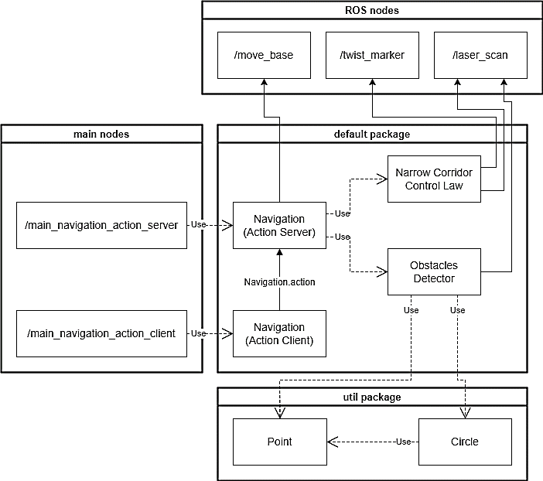
Structure of the project
Conceptual UML diagram:

Slide 5
Structure of the project
Conceptual UML diagram:

Slide 6
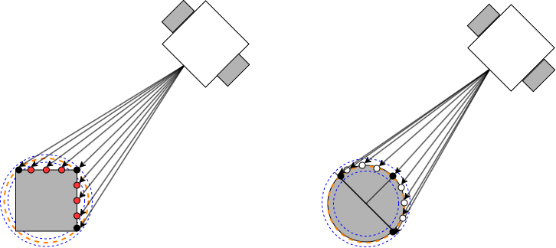
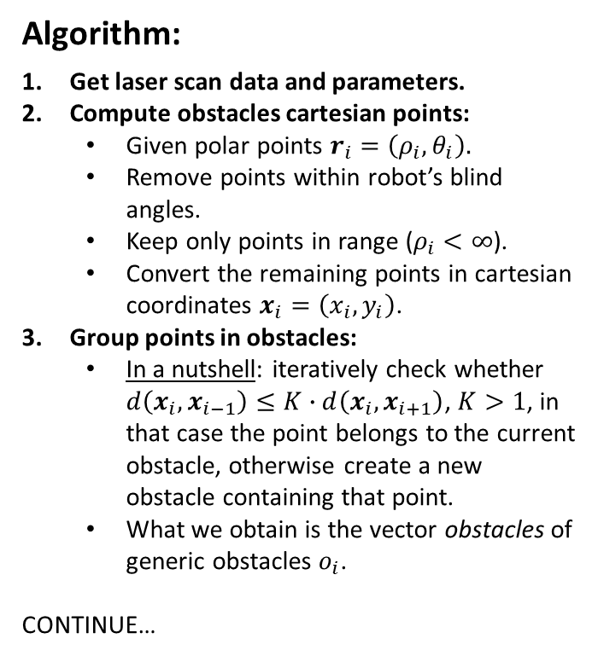
Obstacles Detection
Obstacles detection: Detection of central positions of obstacles
Algorithm:
Get laser scan data and parameters.
Compute obstacles cartesian points:
Given polar points $r_{i}=\left(ρ_{i},θ_{i}\right).$
Remove points within robot’s blind angles.
Keep only points in range ($ρ_{i}<∞$).
Convert the remaining points in cartesian coordinates $x_{i}=\left(x_{i},y_{i}\right)$.
Group points in obstacles:
In a nutshell: iteratively check whether $d\left(x_{i},x_{i−1}\right)≤K∙d\left(x_{i},x_{i+1}\right)$, $K>1$, in that case the point belongs to the current obstacle, otherwise create a new obstacle containing that point.
What we obtain is the vector obstacles of generic obstacles $o_{i}$.
CONTINUE…

Slide 7
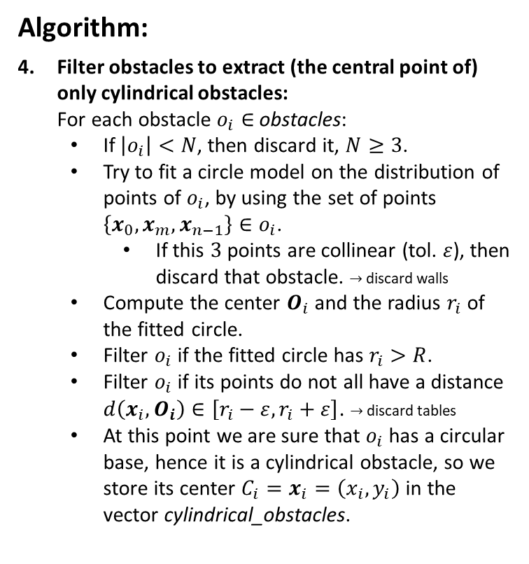
Obstacles Detection
Obstacles detection: Detection of central positions of obstacles
Algorithm:
Filter obstacles to extract (the central point of) only cylindrical obstacles:
For each obstacle $o_{i}∈$ obstacles:
If $\left|o_{i}\right|<N$, then discard it, $N≥3$.
Try to fit a circle model on the distribution of points of $o_{i}$, by using the set of points $\left\{x_{0},x_{m},x_{n−1}\right\}∈o_{i}$.
If this $3$ points are collinear (tol. $ε$), then discard that obstacle. $→$ discard walls
Compute the center $O_{i}$ and the radius $r_{i}$ of the fitted circle.
Filter $o_{i}$ if the fitted circle has $r_{i}>R$.
Filter $o_{i}$ if its points do not all have a distance $d\left(x_{i},O_{i}\right)∈\left[r_{i}−ε,r_{i}+ε\right]$. $→$ discard tables
At this point we are sure that $o_{i}$ has a circular base, hence it is a cylindrical obstacle, so we store its center $C_{i}=x_{i}=\left(x_{i},y_{i}\right)$ in the vector cylindrical_obstacles.

Slide 8
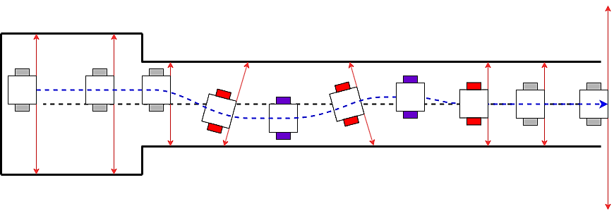
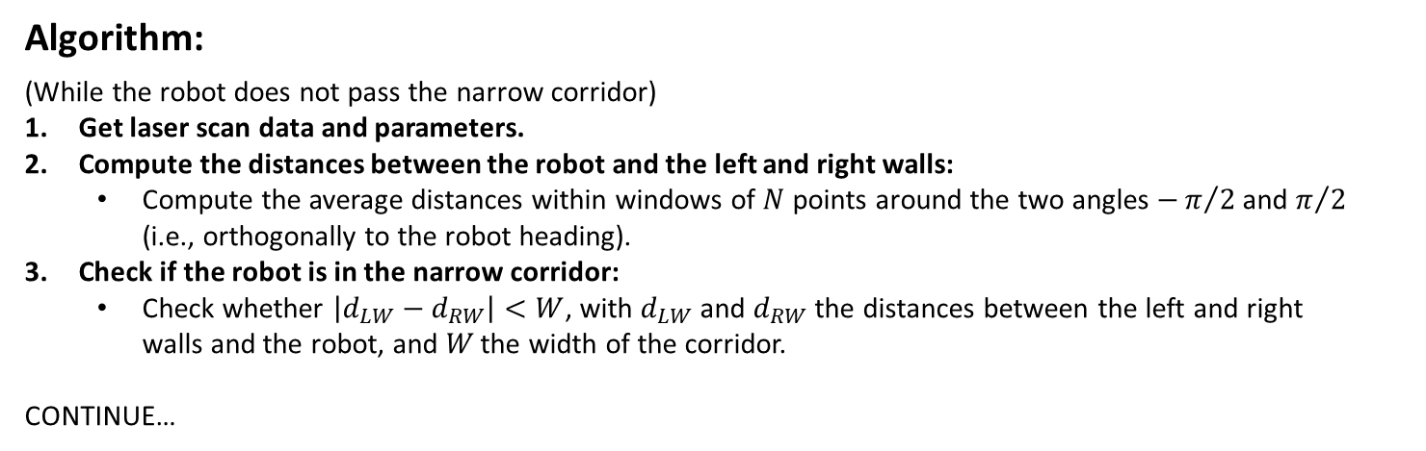
Narrow Corridor Control Law
Narrow corridor control law: Crossing the narrow corridor, keeping in the center
Algorithm:
(While the robot does not pass the narrow corridor)
Get laser scan data and parameters.
Compute the distances between the robot and the left and right walls:
Compute the average distances within windows of $N$ points around the two angles $−π/2$ and $π/2$ (i.e., orthogonally to the robot heading).
Check if the robot is in the narrow corridor:
Check whether $\left|d_{LW}−d_{RW}\right|<W$, with $d_{LW}$ and $d_{RW}$ the distances between the left and right walls and the robot, and 𝑊 the width of the corridor.
CONTINUE…

Slide 9
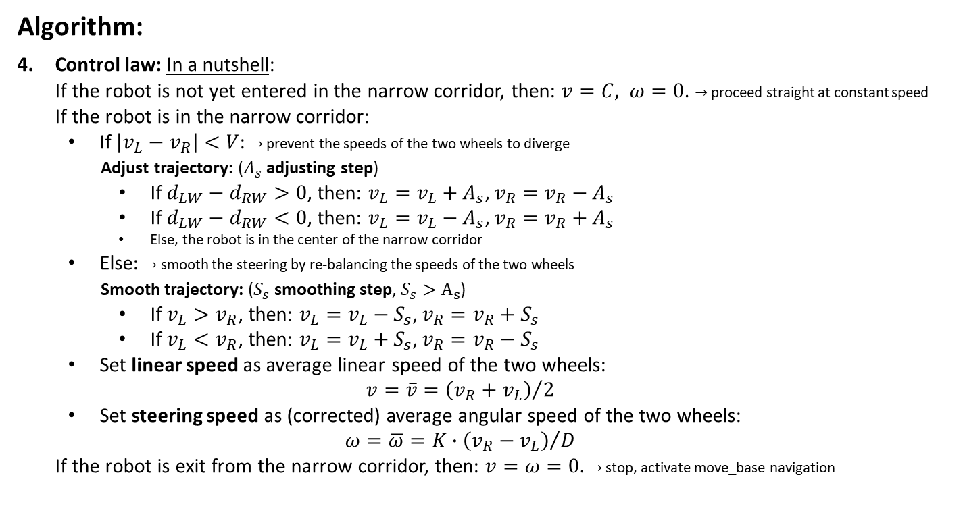
Narrow Corridor Control Law
Narrow corridor control law: Crossing the narrow corridor, keeping in the center
Algorithm:
Control law: In a nutshell:
If the robot is not yet entered in the narrow corridor, then: $v=C, ω=0$. $→$ proceed straight at constant speed
If the robot is in the narrow corridor:
If $\left|v_{L}−v_{R}\right|<V$: $→$ prevent the speeds of the two wheels to diverge
Adjust trajectory: ($A_{s}$ adjusting step)
If $d_{LW}−d_{RW}>0$, then: $v_{L}=v_{L}+A_{s}$, $v_{R}=v_{R}−A_{s}$
If $d_{LW}−d_{RW}<0$, then: $v_{L}=v_{L}−A_{s}$, $v_{R}=v_{R}+A_{s}$
Else, the robot is in the center of the narrow corridor
Else: $→$ smooth the steering by re-balancing the speeds of the two wheels
Smooth trajectory: ($S_{s}$ smoothing step, $S_{s}>A_{s}$)
If $v_{L}>v_{R}$, then: $v_{L}=v_{L}−S_{s}$, $v_{R}=v_{R}+S_{s}$
If $v_{L}<v_{R}$, then: $v_{L}=v_{L}+S_{s}$, $v_{R}=v_{R}−S_{s}$
Set linear speed as average linear speed of the two wheels:
$$v=\overline{v}={\left(v_{R}+v_{L}\right)}/2$$
Set steering speed as (corrected) average angular speed of the two wheels:
$$ω=\overline{ω}=K∙{\left(v_{R}−v_{L}\right)}/D$$
If the robot is exit from the narrow corridor, then: $v=ω=0$. $→$ stop, activate move_base navigation

Slide 10
Assignment 2

Slide 11
Summary Assignment 2
Summary Assignment 2:
Structure of the project
Navigation logic (using tree data structure)
Objects Detection
Objects Manipulation
Extra points part

Slide 12
Structure of the project
Conceptual UML diagram:

Slide 13
Structure of the project
Conceptual UML diagram ➔ Nodes: Definition, communication and motivations

Slide 14
Structure of the project
Conceptual UML diagram ➔ Nodes: Operations within each node (decoupling)

Slide 15
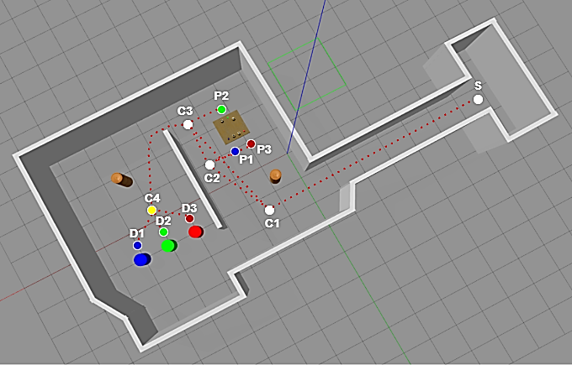
Navigation logic (using Tree)
Navigation logic using tree data structure:

Slide 16
Navigation logic (using Tree)
Navigation logic using tree data structure ➔ Tree build: Subtrees generation (knowing the order of the objects to pick up, from Human Node service server)

Slide 17
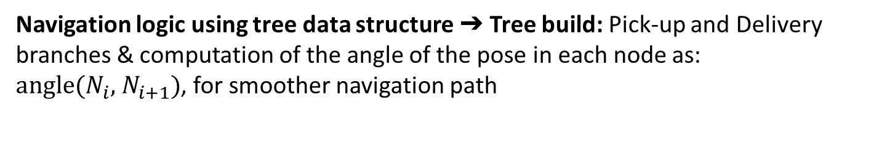
Navigation logic (using Tree)
Navigation logic using tree data structure ➔ Tree build: Pick-up and Delivery branches & computation of the angle of the pose in each node as: $\text{angle}\text{(}N_{i}\text{,} { N}_{i+1}\text{)}$, for smoother navigation path

Slide 18
Navigation logic (using Tree)
Navigation logic using tree data structure ➔ Tree exploration: DFS algorithm

Slide 19
Navigation logic (using Tree)
Navigation logic using tree data structure ➔ Tree exploration: Types of nodes & routines in each node (through callback function called by DFS)

Slide 20

Objects Detection
The Objects Detection part includes:
AprilTag logic, that is implemented in the ObjectsDetector class
Tiago's head movement
Algorithm:
Detection Function (detect_objects_on_pick_up_table):
Wait for a message on the "/tag_detections" topic
For each detected object in the message, the object's pose is transformed from the camera
reference frame to the robot's base link frame
Create a PickUpObject or a PickUpObstacle according to the ID.
Detected objects and obstacles are stored in vectors with also their position

Slide 21
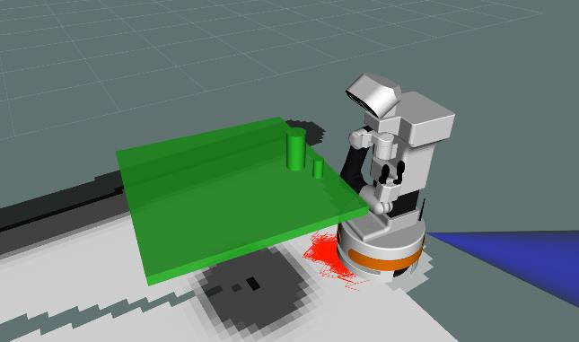
Objects Manipulation
Collison Object with Rviz: First step of object manipulation algorithm is to create collision object with the data received by ObjectsDetector.
For each object found in the vector object_detected and obstacle_detected create a collision object whit shape according to the object's ID.

Slide 22
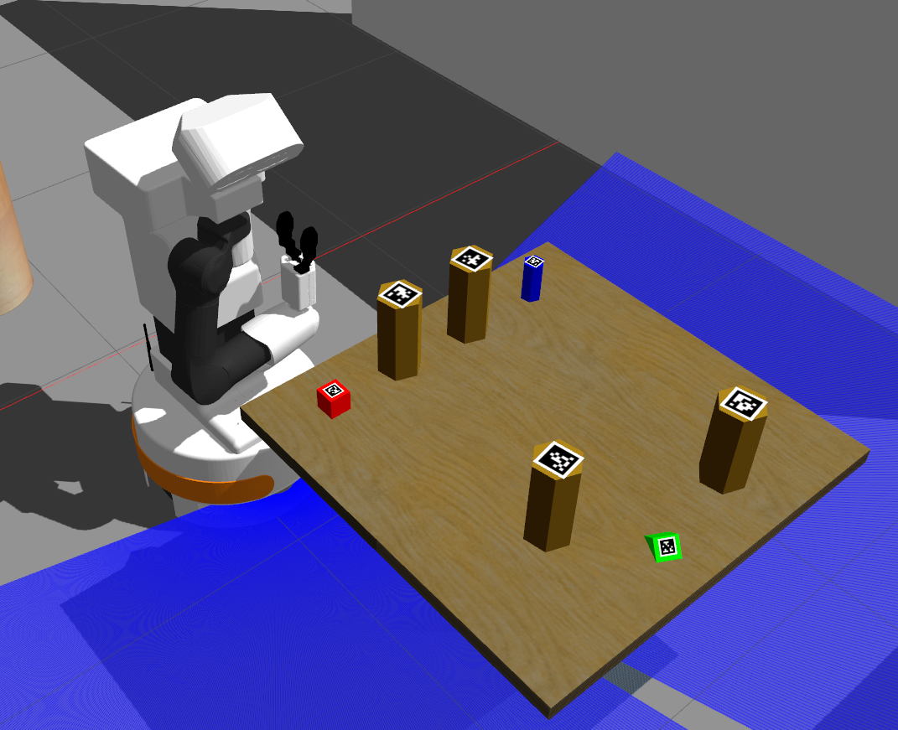
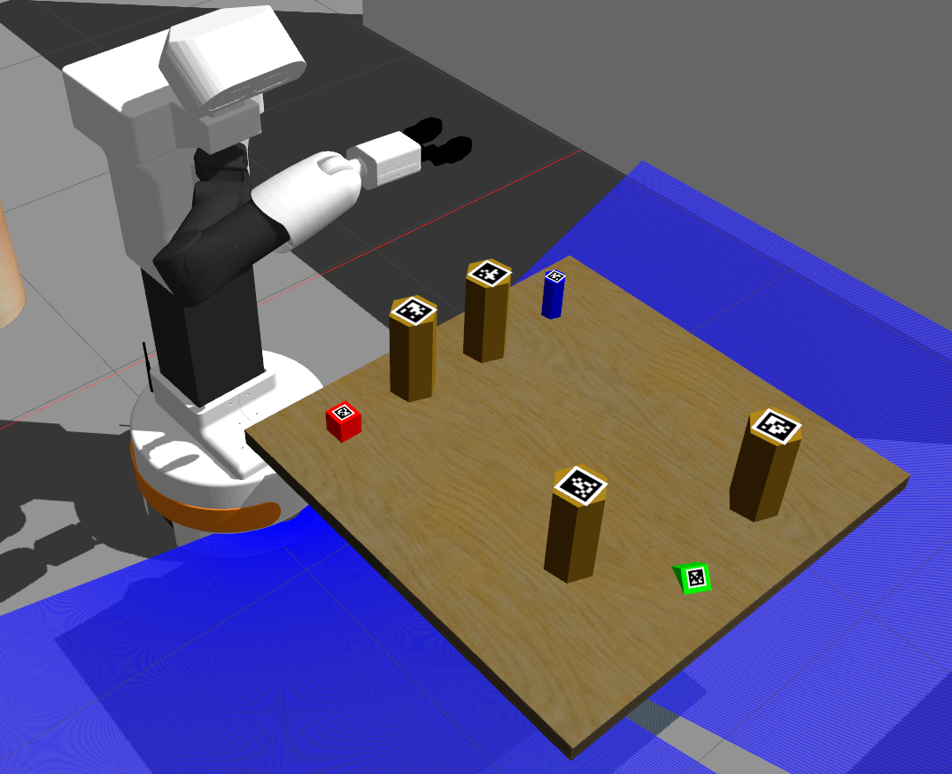
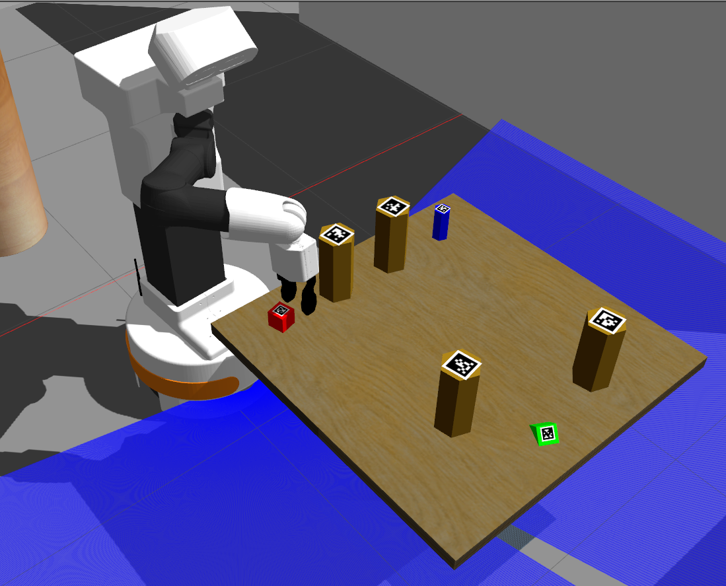
Objects Manipulation
Pick up routine: we defined four poses of Tiago's end effector: Home, Safe, Above_pick and Pick position.
We try to pick all the target objects from the side and from above but the second option seams to give better result.
Home position
Safe position
Above_pick position

Slide 23
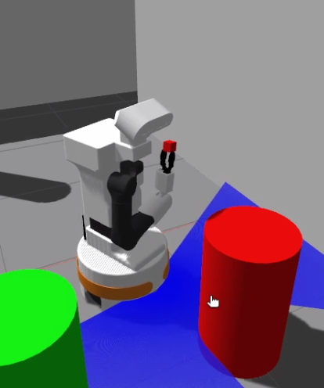
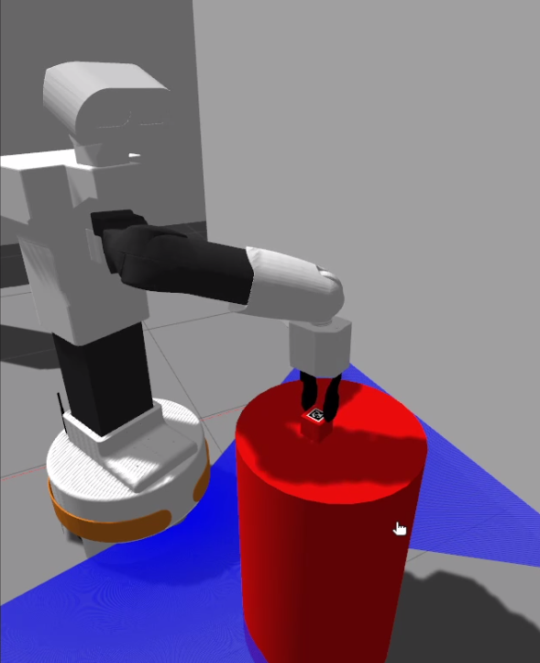
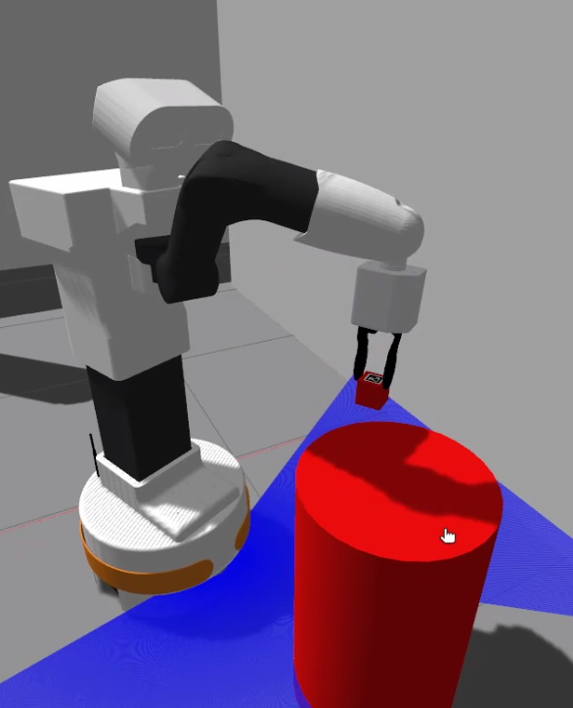
Objects Manipulation
Placing Target Object: we defined again three poses of Tiago's end effector: home, safe_place, and place position based on the ID of the target object. Since the pick up is executed from above even the placing need to be done from above.
Home position
Safe position
Place position

Slide 24
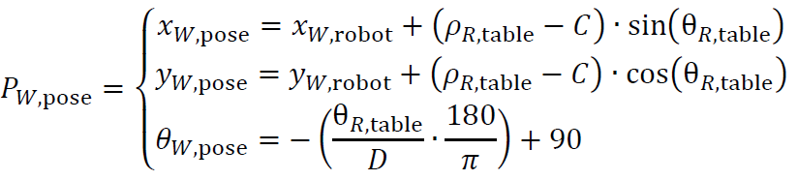
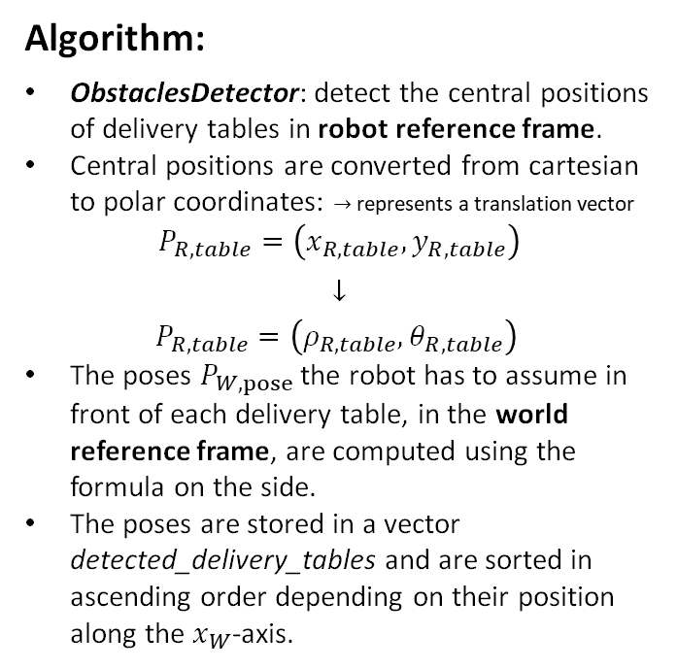
Extra points part
Extra points part ➔ Step 1: Delivery tables central positions detection
Algorithm:
ObstaclesDetector: detect the central positions of delivery tables in robot reference frame.
Central positions are converted from cartesian to polar coordinates: $→$ represents a translation vector
$$P_{R,table}=\left(x_{R,table},y_{R,table}\right)$$
$$↓$$
$$P_{R,table}=\left(ρ_{R,table},θ_{R,table}\right)$$
The poses $P_{W,pose}$ the robot has to assume in front of each delivery table, in the world reference frame, are computed using the formula on the side.
The poses are stored in a vector detected_delivery_tables and are sorted in ascending order depending on their position along the $x_{W}$-axis.

Slide 25
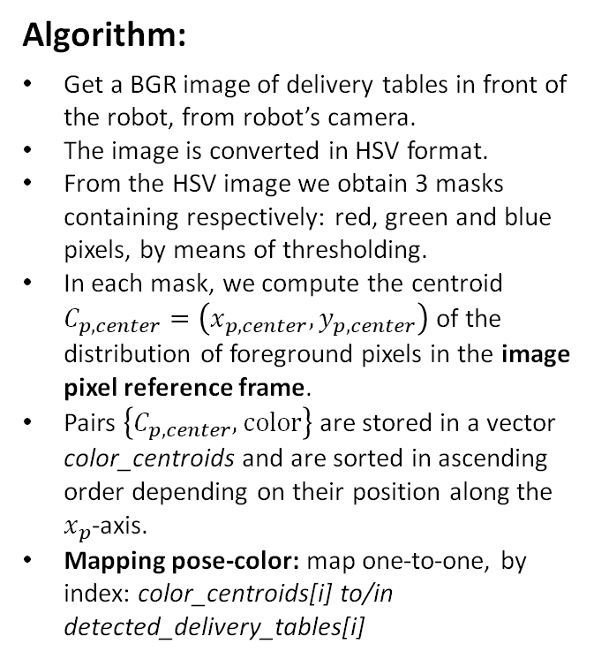
Extra points part
Extra points part ➔ Step 2: Delivery tables colors association
Algorithm:
Get a BGR image of delivery tables in front of the robot, from robot’s camera.
The image is converted in HSV format.
From the HSV image we obtain 3 masks containing respectively: red, green and blue pixels, by means of thresholding.
In each mask, we compute the centroid $C_{p,center}=\left(x_{p,center},y_{p,center}\right)$ of the distribution of foreground pixels in the image pixel reference frame.
Pairs $\left\{C_{p,center}, color\right\}$ are stored in a vector color_centroids and are sorted in ascending order depending on their position along the $x_{p}$-axis.
Mapping pose-color: map one-to-one, by index: color_centroids[i] to/in detected_delivery_tables[i]

Slide 26
Extra points part
Extra points part ➔ Step 3: Correct delivery table selection
Algorithm:
Selection: given the vector detected_delivery_tables and the target_object, we can iterate the vector in order to find the corresponding delivery table, i.e., the one with the same color.

Slide 27
Thanks for your attention!

